Slide 1

Agility and Rigor

Slide 2
Without Rigor, Agility risks chaos
Copyright © 2017 by Peter Merel Confidential and Proprietary

Slide 3
Without Agility, Rigor risks bureaucracy
Copyright © 2017 by Peter Merel Confidential and Proprietary

Slide 4
Agility and Rigor together empower self-organizing teams to drive self-optimizing value streams.
Copyright © 2017 by Peter Merel Confidential and Proprietary

Slide 5
What kind of Rigor?

Slide 6
Breadth-First Product Management
Design, Delivery and DevOps. Hand-in-glove, not hands-off hand-offs.

Slide 7
Triple-Loop Learning
Shorter cycles, smaller meetings, higher cadence.

Slide 8
Throughput Accounting
Consistent numerical focus on the market bottleneck.

Slide 9
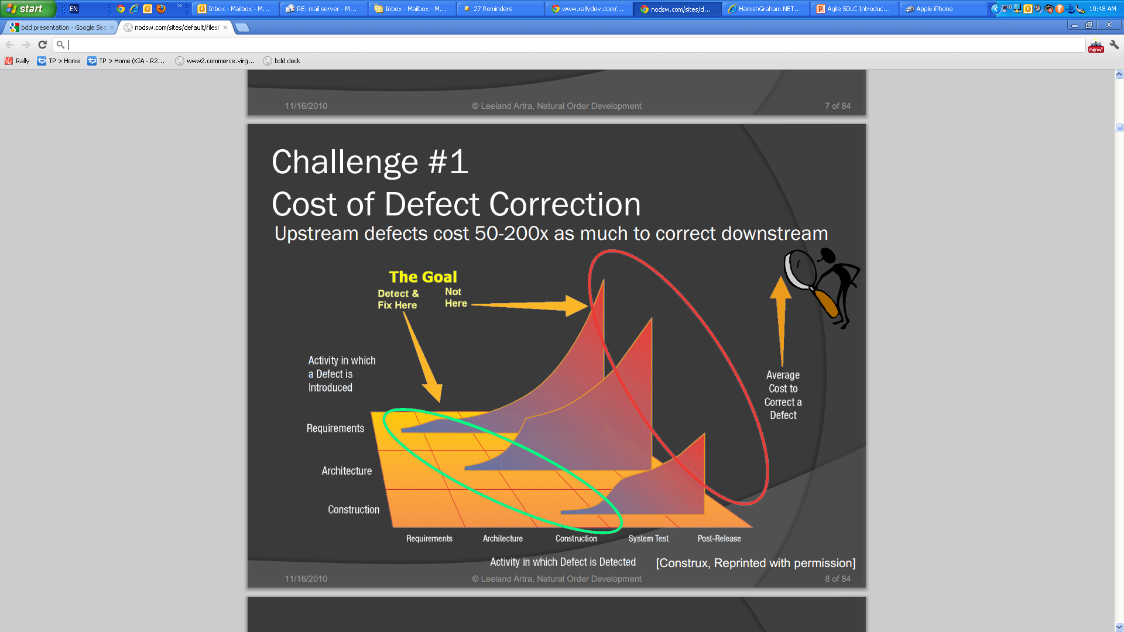
Quality Automation
Flatten cost of change, decentralize ownership and refactor tech debt.

Slide 10
How do we get there?

Slide 11
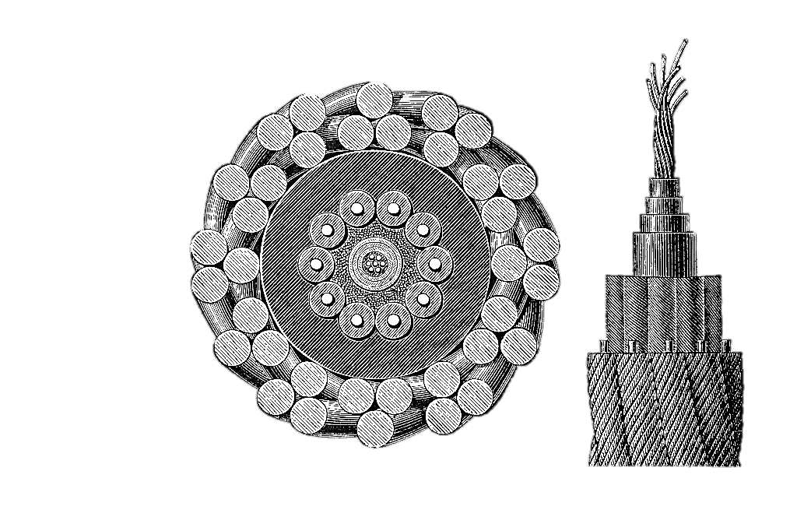
We prove the pudding iteratively
Uncompromised “steel thread streams” continuously prove and improve the kernel of new capability. Split and backfill the streams iteratively, never pushing change into existing streams / teams.
Each iteration’s change recipients become the next iteration’s change agents.
Using Agile to make Agile.
No compromise. No confusion.
Cross-Section of the First Transatlantic Cable

Slide 12
Systematic Improvement
Assessment &
Allocation
Discovery
To open a new scope of improvement we create a whole-board view of maturity and readiness, allocating change agents to specific numerical business and tech objectives.
Alignment &
Awareness
Change stories are prioritized breadth-first to maximize impact and minimize WIP.
We represent change progress using Agile-Lean techniques including Transformation Kanban and Cumulative Flow Diagrams
Inception
Identify and enrol objective leaders; pair them with change agents. Align recipients and leaders by training and mentoring. Establish new channels for direction & support.
Architecture &
Autonomy
Establish a deep but slender “steel thread” enterprise architecture for triple loop learning. Assist in direct interaction of teams, streams and portfolios in two learning aspects.
Mobilisation
Coaching: Role mentoring & team guidance – learning from experience
Collaboration: Split matured streams; add new resource – learning by example
Analytics &
Acceleration
Establish DRIs. Openly share actionable financial and service performance analytics. Rebase individual KPIs on team and business throughput to motivate collaboration. Facilitate high cadence retrospectives, chapters, guilds and open spaces to accelerate the flow of learnings.
Refactoring

Slide 13
Systematic Improvement
 | Architect Foresight | Fix Tech Debt | Lift Delivery Maturity | Agile Product Mgmt. | Agile Portfolio Mgmt. | Formalize Priorities | Lift Velocity To Meet Demand | Distributed Agile | Under-standing Business Goals | Shared Owner-ship | Improve Metrics | Improve Trans-parency
EMT
Direct Reports
Salesforce Teams
Major Pacman
Devops Pacman
Smartfleet (TBD)
HR (TBD)
Mobile First
Acquisitions (TBD)
External Projects
Out of Scope
Uplift Target
Burning Platform

Slide 14
Example: A First Transformation Increment
T-sprint 1.1
T-sprint 1.2
T-sprint 1.3
T-sprint 1.4
T-sprint 1.5
T-sprint 1.6
T-sprint 2.1 …
Product Portfolio Assessment
Organizational Mapping from Hierarchy to Holarchy
Example timeline to represent objectives and activities of a first TI for two product squads and up to 4 squads.
This high level view enabled allocation and time boxing decisions. Actual activities tracked via transformation kanban
Front-loaded training and squad workshops AND Change Owner/Agent Mentoring
Steel thread technical enablers for CI, BDD, Gitflow, environment virtualization and test migration
Steel thread metric automation for product, change and portfolio management in Jira
Coaching for Product Squad – Major Pacman
Coaching for Delivery Squad – Major Pacman
Coaching for Product Squad – Mobile First
Coaching for Delivery Squad – Mobile First
Architectural Assessment & Consolidation
T-sprint 1.1
T-sprint 1.2
T-sprint 1.3
T-sprint 1.4
T-sprint 1.5
T-sprint 1.6
T-sprint 2.1 …

Slide 15
Example: A Second Transformation Increment
T-sprint 2.1
T-sprint 2.2
T-sprint 2.3
T-sprint 2.4
T-sprint 2.5
T-sprint 2.6
T-sprint 3.1 …
Training and Workshops for Portfolio, HR and IT-Allied Business Functions
Coaching the first split of the Major Pacman squads
This engagement model breaks the Transformation Kanban into 12-week “TI” planning cycles.
TI’s are planning increments only. In any TI the client only pays as long as they need us and as long as we produce results.
We scale up and down as needed.
Coaching The first split of the Mobile First squads
Coaching the second split of the Major Pacman squads
Coaching the second split of the Mobile First squads
Institute Lean UX and Set Based Design processes to generate a product innovation capability
Normalize product, delivery and Devops chapter meetings and Portfolio squad/chapter meetings
Consolidate quality model and quality gates and standardize workflow for same in BitBucket
Align and monitor relations between HR, Executive Governance and Non-IT Service Functions with Agile IT capabilities
Instrument ROROI Metrics for Squads, Products and Portfolio reporting
T-sprint 2.1
T-sprint 2.2
T-sprint 2.3
T-sprint 2.4
T-sprint 2.5
T-sprint 2.6
T-sprint 3.1 …

Slide 16
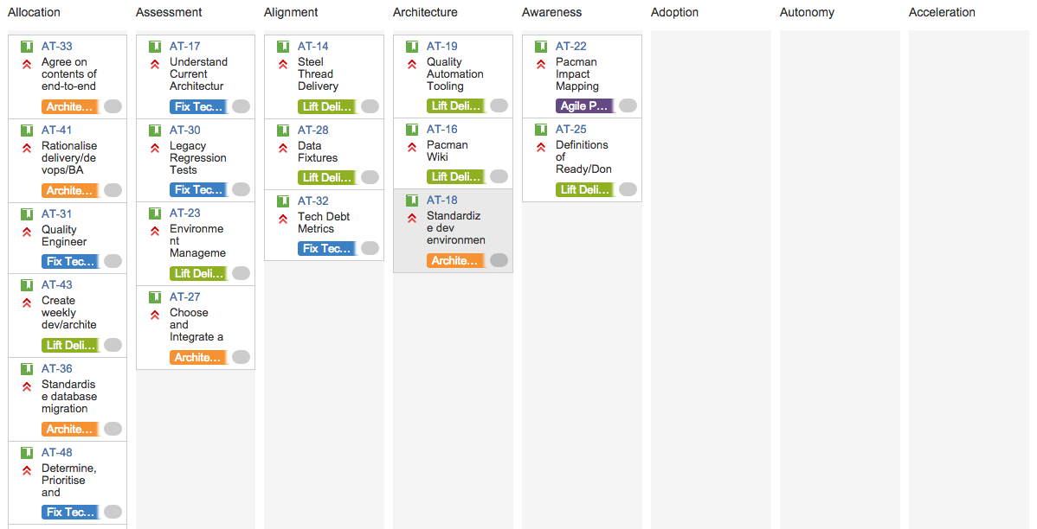
Example Coordination Kanban
Sample coordination kanban with a population of Change Stories.
The coloured labels are Change Epics.
This change workflow is not prescriptive, but ensures we consider all essential steps in completing change stories.

Slide 17
Understanding The Journey
Agile Coordination is a complex, very human activity.
Multi-dimensional, inherently conflicted, intrinsically dynamic.
We cannot plan this journey in MS Project!
We must take an Agile-Lean approach, using a Transformation Kanban and iterative planning with adaptive prioritization.
Agile Coordination is time-sensitive: we have to be very aware of when – how quickly or slowly – things need to be done.
Faster is not always better. But too much delay squanders momentum.
Hierarchic phased strategies are riskier, slower and less effective than teal, metric-driven, T-shaped, event-triggered strategies.

Slide 18
XSCALE Course Outlines
Copyright © 2017 by Peter Merel Confidential and Proprietary

Slide 19
eXponential
TESTS
LEARN
BUILD
Product
REFACTOR
DATA
CODE
MEASURE
Management
Notes:
What happened with “statement”?

Slide 20
XPM is a practice pattern language to continuously align tech, business, and design leaders into a team of peers focused breadth-first on maximizing throughput for market impact, ecosystems growth and ROI.
Key
In Focus
In Context
How do you design an ecosystem for exponential growth?
How do you open a market bottleneck?
How do you measure & maximise ROI?
How do you boil down business drivers for market impact?
How do you get business, design and tech authorities to align doing so?
Notes:
What happened with “statement”?

Slide 21
Exponential Product Management Course Summary
Agile Delivery is a hill-climbing method. It can deliver a minimum viable foothill of value when there’s a maximum market-impact mountain right next door.
Without data-driven, breadth-first, high-impact product management, even the best Product Owner has no way to win. Turning business drivers and market bottlenecks into product backlogs is a problem Scrum, SAFe or LeSS were designed to create, not solve. Without the solution, an Agile team will efficiently deliver the wrong product.
XPM brings together business leaders, design experts and tech authorities into a team of peers called a Product Squad. Product Squads apply simple, lightweight ceremonies that focus breadth-first on disruption of your market. As a traditional product manager/owner, you're often the scapegoat for someone else's confused business direction. This way XPM makes you a servant-leader for a team of peers rapidly sharing innovation and learnings in order to drive tangible digital disruption to market.
Case Study: Kaching
XSCALE was invented on CBA's “Kaching” program, an Agile experiment the bank began in 2012. Kaching was the first practical person-to-person payments app in Australia. Winning a dozen external product awards and going green across the board in the bank's Program Steering Group, it won the CBA Group CIO award for Best Program in the Bank in 2012. A year later it was rebranded “The CBA Mobile App”, valued at $9 Billion. If you’re a CBA customer, Kaching is the secret name of the app in your pocket today.
Kaching and the other programs in the big 4 banks in 2012 was the way it iteratively refined its product definition, release plan and feature priorities. Kaching applied an Agile process that used numbers to harness the best thinking of all team members and stakeholders - technical, business and design. That's what XPM's about.
XPM Practices
Pirate Canvas shows you which market bottleneck your product has to attack next. It measures and maximises the market fit of your business case, quantifies the real business drivers and constraints, and generates an "Epic Landscape" that aligns all stakeholders to a common vision on a single sheet of paper.
Impact Mapping questions the business value of your Epics. It forces you to understand where you have assumptions and gaps in your subject matter expertise that must be filled to avoid building an irrelevant or needlessly limited product. And takes your Product Squad one step further into aligning their frames of reference, which is critical to avoiding subsequent analysis paralysis.
Behavior Analysis starts with patterns for mapping epics to features. It elaborates the INVEST properties per feature in a normal form, then categorizes acceptance criteria according to cross-cutting themes. These themes represent categories of acceptance criteria covering all testable interactions between the product and key user personas, architectural dependencies, non-functional attributes and business rules.
How do you design an ecosystem for exponential growth?
How do you open a market bottleneck?
How do you measure & maximise ROI?
How do you boil down business drivers for market impact?
How do you get business, design and tech authorities to align doing so?

Slide 22
XPM Course Summary (continued)
Acceptance Matrix codifies the output of Behavior Analysis as a broad binary matrix. It systematically combines this with simple sanity-checking questions per feature and per theme to generate closure on all features that could reasonably represent behaviors of the product. This leads the Product Squad members another step into alignment.
Business Bingo is a fast way to generate consensus on actionable numbers for feature cost, business value, risk, ROI and COD. Like all the XPM practices, this is a lightweight and easy to understand numbers game. It starts with empirical probes that represent a metric basis for all the numbers it generates. A comparison game not unlike the traditional XP "Planning Poker" generates the numbers, and the whole Product Squad collaborates in figuring out why these numbers are as they are. Checks and balances sustain the alignment of frames of reference necessary for the Product Squad to rapidly agree on a release plan.
Release Refactoring maximizes ROI across multiple value streams for multiple release dates. Using the per-feature priorities, ROI and budget numbers derived from Business Bingo, it grades the features per Epic similar to the old DSDM MoSCoW method. Because features in this grading aren't smeared across multiple Epics, taking instead the form of a GTD matrix, it's easy for differing stakeholders to rationally evaluate the available trade-offs to maximise ROI per release. This simple numbers game replaced what had been weeks of haggling and politics on Kaching with a few hours of collaboration and extremely successful outcomes.
Leadership as a Service - an Iroquois protocol that eliminates politics and speeds the flow of learning. Already a part of the Agile Planning Poker game, the key here is to understand when and how to apply LaaS at multiple levels so that it becomes a fundamental pillar of the Product Squad's decision-making process.
Throughput Diagrams chart financials that prioritizes ecosystem growth over cutting OpEx. Although the Throughput accounting math is extremely simple, the fallacies inherent in cost accounting run deep. XPM combines McClure's Pirate Metrics with Lean's Cumulative Flow diagrams, drawing on the numbers output by the other XPM practices to generate an unambiguous view of throughput components. This makes it easy to identify the current bottleneck constraint by eye and continuously vary feature priorities to account for it.
How do you design an ecosystem for exponential growth?
How do you open a market bottleneck?
How do you measure & maximise ROI?
How do you boil down business drivers for market impact?
How do you get business, design and tech authorities to align doing so?

Slide 23
eXponential
Dev
REFACTOR
Ops
Notes:
What happened with “statement”?

Slide 24
Exponential DevOps
Key
In Focus
In Context
XDevOps is a critical technical enabler for
Business Agility.
This course teaches how to fit XP, BDD, CD & GitFlow to a rapid round-trip lifecycle that aligns Design, Delivery and Ops hand-in-glove while integrating legacy with Serverless Microservices.
Notes:
What happened with “statement”?

Slide 25
Exponential DevOps Course Summary
It doesn't matter what framework you use. What matters is bottom line throughput. DevOps "Three Ways" – end to end flow, fast feedback loops and continuous experimentation/ improvement – focus your Devs, Ops, and QA on the development of a technical fabric capable of rapid behavior-driven design evolution. This course trains your whole team in the state of the art in high-performance value streams.
XDevOps covers XP, BDD, CD, GitFlow and Serverless Microservices practice patterns. Why these patterns and not others?
CD is critical to end to end flow, because code that doesn't reach production is just WIP.
XP minimizes tech debt, the critical challenge to achieving Continuous Deployment.
BDD enables BA/QA/Ops to automate tests without coding while slashing costs of quality.
GitFlow enables multiple teams to integrate and deploy on-demand without waiting for long-cycle Release Trains.
Serverless represent a disruptive tech wave that will obsolete almost all server-based cloud technologies.
This combination puts the X in XDevOps. But the course isn't just about the shiny green field of future tech. All enterprises carry a heavy burden of in-house and cloud-based legacy, so the XDevOps course covers patterns for migrating and integrating legacies into the NoOps world using AWS Lambda, which offers the most mature Serverless stack at this time..
Product, Feature & Systems Squads
XDevOps brings Testers, BAs, Ops, Designers and Devs together as peers in a self-organizing team called a Squad. There are two kinds of Squad covered by this training. One focuses on delivery Feature by Feature. The other progresses the systems architecture and operational competencies essential to the first. We call the first kind a Feature Squad, and the second a Systems Squad.
Each value stream's priorities are focused by a Product Squad, in which representatives of the Feature and Systems Squads collaborate with Design and Business authorities to interpret analytics to define product backlogs according to the breadth-first Exponential Product Management practices, Together the three flavours of squad self-organize into a rapid round-trip lifecycle that aligns with other streams through a system of chapters and councils to form an Agile Organization.
Both Feature Squads and Systems Squads require a grounding in the common XP and DevOps fundamentals. This is delivered in the XDevOps course through a fun, Lego-based simulation to ensure everyone on the team shares a common vision before diving into the technical practices.
XDevOps is a critical technical enabler for
Business Agility.
This course teaches how to fit XP, BDD, CD & GitFlow to a rapid round-trip lifecycle that aligns Design, Delivery and Ops hand-in-glove while integrating legacy with Serverless Microservices.

Slide 26
XDevOps Course Summary Continued
XDevOps Lego Simulation
How to elaborate acceptance criteria for epics, features and stories via behavior driven analysis
How to groom your backlog for INVEST properties + story prioritization and estimates / noEstimates
Agile Organization team ceremonies: standups, chapters, rapid retros, and Leadership as a Service
Kanban practices: one-piece flow, pulling the work and quantification of waste, stress and wobble
How to apply XP Shared Ownership, Spiking, Pair Programming & YAGNI practices day-to-day
Merciless Mob Refactoring and the use of Refactoring Patterns on Microservices
Theory of Constraints and Throughput Accounting for Feature and Story Prioritization
Feature Squad Practices
Developing and deploying business-valuable changes to production, one BDD Feature at a time:
How the “3 amigos” elaborate Feature acceptance criteria to well-formed BDD
How to reconcile story level estimates/noEstimates against the Feature budget
How to run the outside-in red-green-refactor test-first delivery kata for a story
Merciless refactoring of code, tests and data to continuously minimize tech debt
Systematic migration of BDD step implementations from CI to FIT, SIT, Load & Soak
Continuous Deployment with code running green into Production, not merely CI.
Systems Squad Practices
To optimise the performance of existing system behavior while paying down cross-cutting costs of quality, maintenance, and tech debt:
Migrating undocumented, untested legacy services through BDD "Test Injection"
Using BDD to control system configuration as code / infrastructure as code.
Serverless qualification flows for CI, FIT and SIT, Load and Soak
Service migrations between legacy layers and serverless fabrics
Orchestrating gitflow to feed OpsDev hot-fixes back to Feature Squads
Managing 24 x 7 production support via automated and social help desks
Configuring common functions, platform updates and 3rd-party agents
Refactoring BDD fabrics to reduce costs of quality
XDevOps and Scrum
DevOps' Continuous Deployment doesn't really fit with Scrum roles and time-boxes. At a minimum you'll need Scrumban.
In the form of the XP practices, XDevOps is closely aligned with the Software Craftsmanship movement and Kanban, So Scrum Masters may have some learning & unlearning to do, but this course makes it easy to for a CSM to see what’s different and why.
XDevOps is a critical technical enabler for
Business Agility.
This course teaches how to fit XP, BDD, CD & GitFlow to a rapid round-trip lifecycle that aligns Design, Delivery and Ops hand-in-glove while integrating legacy with Serverless Microservices.

Slide 27
eXponential
Business
Agility
Notes:
What happened with “statement”?

Slide 28
A practice pattern language to continuously align multiple Agile squads to exponential bottom-line throughput. XBA accelerates flow of learning across value streams, focusing them on opening bottlenecks to service ecosystem growth.
Key
In Focus
In Context
XBA teaches how to continuously align multiple Agile teams to bottom line ROI.
It generates self-organizing value streams, each focused on its own specific mission to open a bottleneck to the growth of its service ecosystem.
Notes:
What happened with “statement”?

Slide 29
Exponential Business Agility Course Summary
An Agile organization isn’t a dancing elephant. It’s a pod of dolphins.
Traditional business management practices can't communicate learnings efficiently among fast-paced, autonomous Agile teams, nor align their priorities quickly enough to keep the left hand coordinated with the right. XBA teaches managers, execs and coaches how to enable autonomous teams to continuously self-align to maximise their mutual benefit and market impact. XBA includes:
Throughput accounting rather than cost-accounting as the basis for business decisions
Mission-command, DRIs & Leadership as a Service to prevent bureaucracy and politics
Self-organizing transformation - a rapid, reliable, risk-free but uncompromising change method
Self-aligning “DevOps" value streams to shorten collaboration loop lengths and feedback periods
Dynamic leadership councils to empower teams of doers to represent themselves without middlemen
Breadth-first product management to continuously adapt stream priorities for maximum market impact
Every aspect of Business Agility is represented by a simple set of best-practice patterns. The XBA course starts with a Lego-based simulation of all of these working together, a “Game Without Thrones" to generate a shared mental model of Agile Organization. Once students become comfortable with this model in Lego, XBA drills down on each practice to provide clear understanding and hands-on experience in a real world context.
Throughput Accounting
Traditional Cost Accounting, which attempts to maximise utilisation and minimise operating expense, forms an illogical basis for management decisions. Modern MBAs teach Goldratt’s rational alternative, Throughput Accounting, which instead measures and optimises throughput as Operating Expense + Net Profit. XBA applies this approach to ecosystems growth represented by cumulative flow and "pirate metric" diagrams.
Mission-Command This isn’t about sacking the management, but replacing command and control decision-making with a simple consensus-generating protocol called Leadership as a Service. This protocol maximises learning flows for capability leadership, systems leadership, product leadership and portfolio leadership. It accelerates communication between teams while aligning them to resolve cross-cutting constraints for mutual benefit.
Exponential Transformation Use Agile to deliver Agile. Iteratively convert change recipients into change agents without ever pushing change into existing teams, programs or silos. Graft the kernel of an Agile Organization onto the trunk of an old corporate culture, then grow it organically. This kernel is a slender but uncompromised stream of progressive staff. Once mature, we split it down the middle and back-fill each half. Doubling capability at every split generates an exponential rate of change without risks of business disruption or Agile compromise.
.
XBA teaches how to continuously align multiple Agile teams to bottom line ROI.
It generates self-organizing value streams, each focused on its own specific mission to open a bottleneck to the growth of its service ecosystem.

Slide 30
XBA Course Summary (continued)
DevOps Value Streams
DevOps began as a simple way to improve collaboration between delivery and ops by treating infrastructure as code, but it has matured into a unification of Agile, CD, Lean Startup and Throughput Accounting principles and practices. XSCALE Alliance trains the technical aspects in its 2 day training course in XDevOps, which adds in BDD, GitFlow and Serverless Microservices. The XBA course teaches business leaders how to continuously adapt to the round-trip flow of design, delivery and deployment using hand-in-glove metric feedback and triple-loop learning.
Holarchic Leadership
In a hierarchy, managers form stable tree structures to channel communications between temporary teams of doers and to make decisions about privileged business information. In a holarchy, stable teams of doers openly share this business information and form cross-cutting chapters that stripe their teams as communication channels. Each chapter generates treaties to represent inter-team alignment and dynamically picks representatives to participate in a council that coordinates people management and change management priorities.
Leadership as a Service
An Iroquois protocol that eliminates politics and speeds the flow of learning. Already a part of the Agile Planning Poker game, the key here is to understand when and how to apply LaaS at multiple levels so that it becomes a fundamental pillar of the Product Squad's decision-making process.
Throughput Diagrams
Chart financials to prioritize ecosystem growth over cutting OpEx. Although the Throughput accounting math is extremely simple, the fallacies inherent in cost accounting run deep. XPM combines McClure's Pirate Metrics with Lean's Cumulative Flow diagrams, drawing on the numbers output by the other XPM practices to generate an unambiguous view of throughput components. This makes it easy to identify the current bottleneck constraint by eye and continuously vary feature priorities to account for it.
Breadth-first Portfolio Management
The Exponential Product Management course trains business, design and technical authorities in a set of practices that systematically convert business drivers and constraints into well-formed BDD product backlogs prioritized for maximum market impact.
XBA broadens the XPM practices to balance portfolios of value streams to maximise ROI, enabling quantitative trade-offs to open bottlenecks across product growth curves and constraints.
XBA teaches how to continuously align multiple Agile teams to bottom line ROI.
It generates self-organizing value streams, each focused on its own specific mission to open a bottleneck to the growth of its service ecosystem.

Slide 31
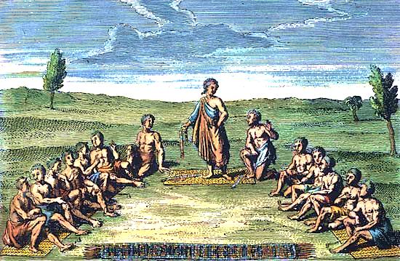
eXponential
Agile
Practices
REFACTOR
Notes:
What happened with “statement”?

Slide 32
Exponential Agile Practices
Key
In Focus
In Context
XAP is a “T-shaped” fast start for people with no previous Agile experience.
XAP begins with a clear orientation to the breadth of the Agile landscape.
It grounds learnings via hands-on application of best practices and core metrics for high performing Agile teams.
Notes:
What happened with “statement”?

Slide 33
Exponential Agile Practices Course Summary
Comparative metrics show a 10x difference between high-performing Agile teams and ordinary “Scrums”. Evolving one to the other yields a phase change in team dynamics like a solid turning to liquid.
The 10x doesn’t come from individual certification or heroism, but adherence to key team disciplines that minimize costs of quality, delay, and learning.
These disciplines are all based on a very simple kernel of practice patterns. While the ”Agile Churches” may claim that their particular method is the one and only, high performing Agile teams don’t care about Agile methods. They care about optimizing sustainable throughput.
This course teaches that central core of Agile practices hands-on using a child-like Lego game. This tinker-toy perspective makes Agile working quick and easy to grasp so yields immediate literacy across the whole team and profound insight into the essential mindset and profound business benefits of Agile working.
Delivery practice misalignments risk productivity loss, technical debt and interpersonal friction so all Execs, Managers, Devs, BAs, Testers and Designers in any XSCALE transformation may undertake the XAP training together.
XAP covers:
Why and how Agile is Quicker, Cheaper and Better
The four extra benefits of Agile adoption
Why and how to replace project management with product management
Feature Squads vs. Component Squads
How to reconcile Product Constraints against Business Value and Quality in the Agile Triangle
Agile fundamentals – Squads, Sprints and Stories
How Agile teams self-organize to track, prioritize and estimate their work
How-to: Grooming feature and story backlogs to maximize ROI and minimize COD.
The fundamental Agile ceremonies – standups, planning games, sprint reviews and sprint retros
Simulation of the core of XP, BDD, CD and Scrumban.
How-to: Grooming feature and story backlogs to maximize ROI and minimize COD.
How to track, read and report metrics continuously using cumulative flow diagrams in Jira, Rally, etc. or just on a card wall.
What “scaling” via LeSS, SAFe, ES, Nexus, Spotify, etc. really means day to day.
Why CD and Behavior Driven Development are critical to maximizing sustainable throughput.
First steps and and next steps on the journey: using Agile to roll out Agile
XAP is a “T-shaped” fast start for people with no previous Agile experience.
XAP begins with a clear orientation to the breadth of the Agile landscape.
It grounds learnings via hands-on application of best practices and core metrics for high performing Agile teams.

Slide 34
Agility and Rigor
Copyright © 2017 by Peter Merel Confidential and Proprietary

